Slide 1


An Essential
Guide to E/M
Coding

Slide 2

The AMA Initiative
The AMA prompted CMS to give them time to develop new documentation guidelines.
AMA workgroup was created to achieve the following goals:
Decreased administrative burden of documentation & coding.
Decreased need for audits.
Decreased unnecessary documentation in the medical record not needed for patient care.
Ensure that payment for E/M is resource based and has no
direct goal for payment redistribution between specialties.
Doctors created their own guidelines and CMS accepted these in
full in the Final Rule for 2020. AMA involvement means these
guidelines will be industry-wide for all payers.

Slide 3
Summary of Changes
E/M documentation will now be focused on MDM (medical decision making) or time.
History and Exam elements are only to be captured when clinically appropriate.
Code 99201 will be eliminated as the requirements for MDM are the same as 99202.
CPT 99211 still exists, but there are no specific MDM or time requirements. This is a "minimal" visit.
CPT guidelines were substantially revised to remove the gray areas and provide accurate code selection.
Provider can use either time-based or MDM method, whichever is the most beneficial for the visit.
Bottomline
Documentation should be sufficient for a subsequent provider treating
the patient and a proper legal defense.

Slide 4

Criteria of MDM
Created sufficient detail in CPT code set to reduce variation between contractors/payers.
Attempted to align criteria with clinically intuitive concepts .
Used existing CMS and contractor tools to reduce disruption in coding patterns.
Removed ambiguous terms (e.g., "mild") and defined previously ambiguous concepts (e.g., "acute or chronic illness with systemic symptoms").
While similar, this is not the MDM calculation we have today.
All code descriptors state a "medically appropriate" history and/or examination and MDM.
Amount of history and exam performed and documented up to the
provider will not be a consideration in code selection.

Slide 5
Levels of MDM
CPT | MDM
99202 | Straightforward
99203 | Low
99204 | Moderate
99205 | High
99212 | Straightforward
99213 | Low
99214 | Moderate
99215 | High

Slide 6
New Medical Decision-Making Tree
CODE/MDM | Elements of Medical Decision Making
Code | Level of MDM | Number and Complexity of Problems Addressed | Amount and/or Complexity of Data to be reviewed and Analysed. *each unique test, order or document contributes to the combination of 2 or combination of 3 in category 1 below* | Risk of Complication and/or Morbidity or Mortality of Patient Management
99211 | N/A | N/A | N/A | N/A
99202 99212 | Straightforward | Minimal. 1 self-limited or minor problem | Minimal or none | Minimal risk of morbidity from additional diagnostic testing or treatment
99203 99213 | Low | Low 2 or more self-limited or minor problems; OR 1 stable chronic illness; OR 1 acute, uncomplicated illness or injury | Limited (Must meet the requirements of at least 1/22 categories) Category 1 : Test and documents Any combination of 2 from the following: Review of prior external note(s) from each unique source*; Review of the result(s) of each unique test*; Ordering of each unique test* OR Category 2 : Assessment requiring an independent historian(s) (For the categories of independent interpretation of tests and discussion of management or test interpretation, see moderate or high) | Low risk of morbidity from additional diagnostic testing or treatment

Slide 7
CODE/MDM | Elements of Medical Decision Making
Code | Level of MDM | Number and Complexity of Problems Addressed | Amount and/or Complexity of Data to be reviewed and Analysed. *each unique test, order or document contributes to the combination of 2 or combination of 3 in category 1 below* | Risk of Complication and/or Morbidity or Mortality of Patient Management
99204 99214 | High | Moderate 1 or more chronic illness with severe exacerbation, progression, or side effects of treatment; OR 2 or more stable chronic illnesses OR 1 undiagnosed new problem with uncertain prognosis; OR 1 acute illness with systemic symptoms; OR 1 acute complicated injury | Moderate (Must meet the requirements of at least 3 categories) Category 1 : Tests, documents, or independent historian(s) Any combination of 3 from the following: Review of prior external note(s) from each unique source*; Review of the result(s) of each unique test*; Ordering of each unique test* Assessment requiring an independent historian(s) OR Category 2 : Independent interpretation of tests Independent interpretation of a test performed by another physician/other qualified health care professional (not separately reported); OR Category 3 : Discussion of management or test interpretation Discussion of management or test interpretation with external physician/other qualified health care professional (not separately reported) | Moderate risk of morbidity from additional diagnostic testing or treatment Examples only: Prescription drug management Decision regarding minor surgery with identified patient or procedure risk factors Decision regarding elective major surgery without identified patient or procedure risk factors Diagnosis or treatment significantly limited by social determinants of health

Slide 8
CODE/MDM | Elements of Medical Decision Making
Code | Level of MDM | Number and Complexity of Problems Addressed | Amount and/or Complexity of Data to be reviewed and Analysed. *each unique test, order or document contributes to the combination of 2 or combination of 3 in category 1 below* | Risk of Complication and/or Morbidity or Mortality of Patient Management
99205 99215 | High | High 1 or more chronic illness with severe exacerbation, progression, or side effects of treatment; OR 1 acute or chronic illness that poses a threat to life or bodily function | Extensive (Must meet the requirements of at least 2/3 categories.) Category 1 : Tests, documents, or independent historian(s) Any combination of 3 from the following: Review of prior external note(s) from each unique source*; Review of the result(s) of each unique test*; Ordering of each unique test* Assessment requiring an independent historian(s) Category 2 : Independent interpretation of tests Independent interpretation of a test performed by another physician/other qualified health care professional (not separately reported); Category 3 : Discussion of management or test interpretation Discussion of management or test interpretation with external physician/other qualified health care professional (not separately reported) | High risk of morbidity from additional diagnostic testing or treatment Examples: Drug therapy requiring intensive monitoring for toxicity Decision regarding elective major surgery with identified patient or procedure risk factors Decision regarding emergency major surgery Decision regarding hospitalization Decision not to resuscitate or to de-escalate care because of poor prognosis

Slide 9
Elements of MDM
While similar, this is not the MDM calculation we have today.
Number of complexity of problems addressed.
Amount and/or complexity of data to be reviewed and analyzed
Risk of complications and/or morbidity or mortality of patient management
Guidelines are the same for new and established patients.

Slide 10
Number and Complexity of Problems Addressed
A problem is addressed or managed when it is evaluated or treated at the encounter by the physician or other qualified healthcare professional reporting the service. This includes consideration of further testing or treatment that may not be elected by virtue of risk/benefit analysis or patient/parent/guardian/surrogate choice.
Notation in the patient's medical record that another professional is managing the problem without additional assessment or care coordination documented does not qualify as being addressed or managed by the physician or other qualified healthcare professional reporting the service.
Referral without evaluation (by history, exam, or diagnostic study[ies]) or consideration of treatment does not qualify as being addressed or managed by the physician or other qualified healthcare professional reporting the service.

Slide 11
Summary of Definitions
Problems Addressed | Condition evaluated at the encounter by the reporting provider
Self-limited or minor | Transient and runs a definite and prescribed course
Minimal | Problem that runs a defined & prescribed course, is transient, and not likely to permanently alter health status
Acute | Recent or new short-term problem
Chronic | Expected duration of at least a year or until death of the patient
Uncomplicated | Treatment considered but low risk of morbidity
Complicated | Extensive injury that requires evaluation of body systems that are not part of the injured organ
Stable | Patient has met treatment goals
Systemic symptoms | Symptoms cause a high risk of morbidity without treatment
Exacerbation | Worsening but does not require hospitalization
Severe exacerbation | Progression with significant risk of morbidity and may require hospitalization
Undiagnosed | Differential diagnosis that likely results in a high risk of morbidity without treatment
Threat to life or bodily function | Poses a threat in near term without treatment

Slide 12
Number and Complexity of Problems Addressed
No consideration given for new conditions
Problems addressed should be “clinically relevant”
Level | Problems Addressed
Straightforward | Self-limited
Low | Stable, uncomplicated, single problem
Moderate | Multiple problems or significantly ill
High | Very ill

Slide 13

Amount and/or
Complexity of Data to be
Reviewed and Analyzed
Data are divided into three categories:
Tests, documents, orders, or independent historian(s)—each unique test, order, or document is counted to meet a threshold number
Independent interpretation of tests—not to be reported separately
Discussion of management or test interpretation with external physician/other QHP/appropriate source—not to be reported separately)
Emphasizes clinically important activities. Accounts for quantity of documents ordered/reviewed and creates "counting rules".

Slide 14
Example of Elements of Medical Decision Making
Code | Level of MDM | Amount and/or Complexity of Data to be reviewed and Analysed. *each unique test, order or document contributes to the combination of 2 or combination of 3 in category 1 below*
99204 99214 | High | Moderate (Must meet the requirements of at least 1/3 categories.) Category 1 : Tests, documents, or independent historian(s) Any combination of 3 from the following: Review of prior external note(s) from each unique source*; Review of the result(s) of each unique test*; Ordering of each unique test* Assessment requiring an independent historian(s) Category 2 : Independent interpretation of tests Independent interpretation of a test performed by another physician/other qualified health care professional (not separately reported); Category 3 : Discussion of management or test interpretation Discussion of management or test interpretation with external physician/other qualified health care professional (not separately reported)

Slide 15
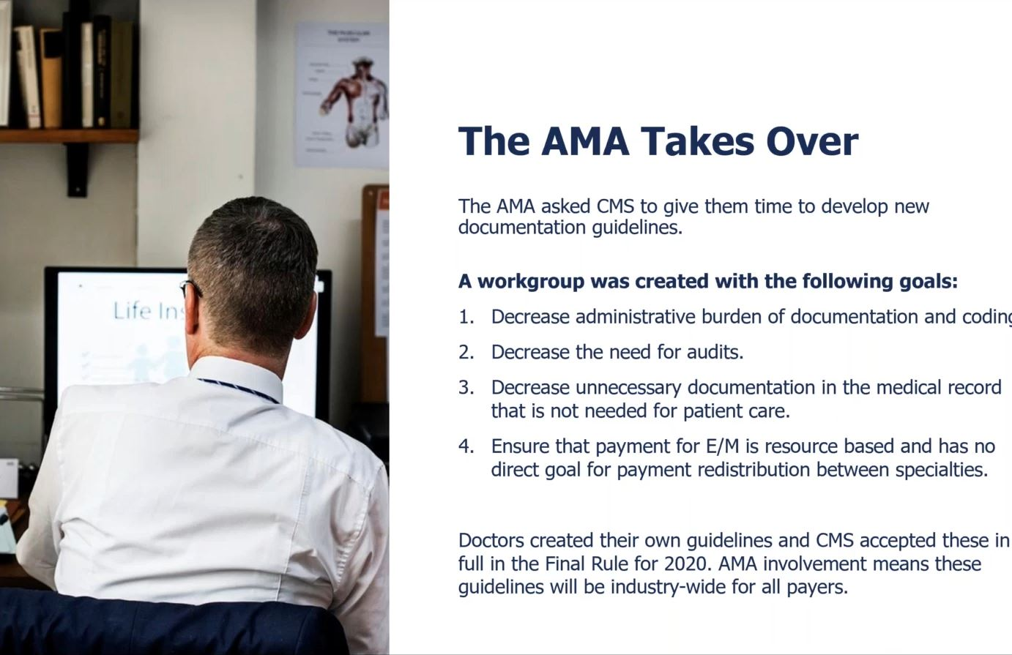
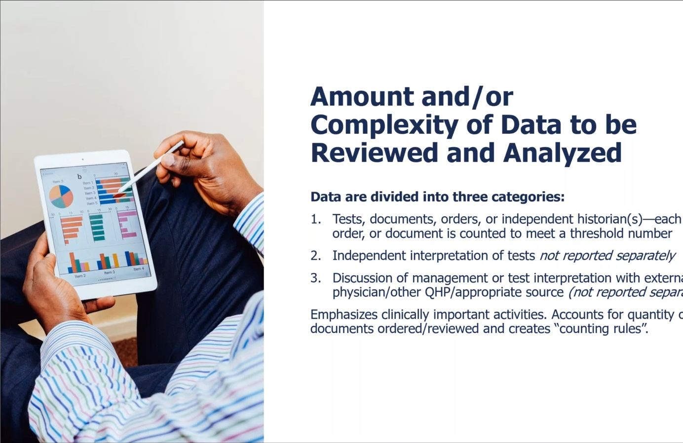
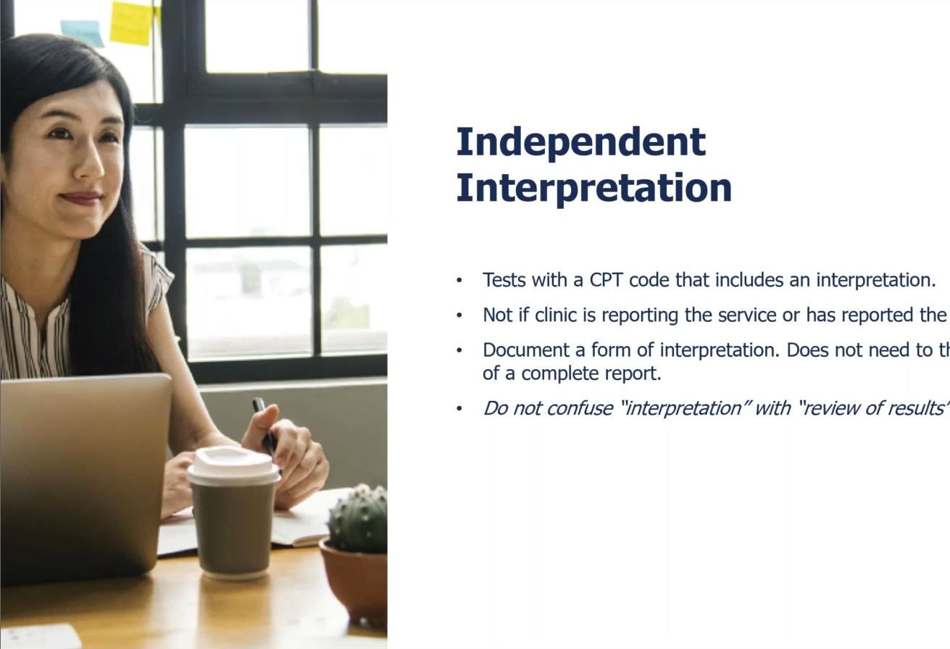
Independent
Interpretation
Tests with a CPT code that includes an interpretation
Not to report if clinic is reporting the service or has reported the service.
Document some form of interpretation. Does not need the usual standards of a complete formal report.
"Interpretation" is often confused with "Review of Results'.'

Slide 16
Appropriate Source
Includes discussion with non-healthcare professionals.
Must be involved in the management of the patient.
Does not include family or informal caregivers.
Examples:
Case Manager
Parole Officer
Professional Caregiver
Lawyer
Teacher

Slide 17
Amount and/or Complexity of
Data to be Reviewed and Analysed
Categories are not the same for each level.
Level | Data Reviewed
Straightforward | Minimal or None
Low | 1 category only 2 documents or independent historian
Moderate | 1 category only Count: 3 items between documents and independent historian; or interpret; or confer
High | 1 category only Same concepts as moderate

Slide 18
Risk of Complications and/or Morbidity or Mortality of Patient Management
Decisions involved with the patient's problem(s) or treatment(s)
Includes possible management options selected and those considered, but not selected
Addresses risks associated with social determinants of health
Examples are included in the table for moderate or high risk only.

Slide 19
Example on Elements of Medical Decision Making
Code | Level of MDM | Risk of Complications and/or Morbidity or Mortality of Patient Management
99205 99215 | High | High risk of morbidity from additional diagnostic testing or treatment Examples: Drug therapy requiring intensive monitoring for toxicity Decision regarding elective major surgery with identified patient or procedure risk factors Decision regarding emergency major surgery Decision regarding hospitalization Decision not to resuscitate or to de-escalate care because of poor prognosis

Slide 20
Social Determinants
Social determinants of health: Economic and social conditions that influence the health of people and communities
Social determinants of health appear under moderate complexity for codes 99204 and 99214.
Consider this as diagnosis or treatment significantly limited by social determinants of health.
Examples may include but not limited to:
Unemployment
Extreme poverty
Nutrition/Food
Housing insecurity and safety
Welfare risks

Slide 21
Risk of Complications and/or Morbidity or Mortality of Patient Management
Level | Data Reviewed
Straightforward | Minimal risk from treatment (including no treatment) or testing. (Most would consider this effectively as no risk)
Low | Low risk (i.e., very low risk of anything bad), minimal consent/discussion
Moderate | Would typically review with patient/surrogate, obtain consent and monitor, or there are complex social factors in management
High | Need to discuss some pretty bad things that could happen for which physician or other qualified health care professional will watch or monitor

Slide 22
Add-on Code for
Chronic Conditions
GPC1X
Visit complexity inherent to evaluation and management associated with medical care services that serve as the continuing focal point for all needed healthcare services and/or with medical care services that are part of ongoing care related to a patient's single, serious, or complex chronic condition. (Add-on code, list separately in addition to office/outpatient evaluation and management visit, new or established)
Code added by CMS for the additional work involved in chronic conditions.
Effective January 1, 2021
No specialty distinction
Report whether the visit is based on MDM or time

Slide 23

TIME BASED CODING CHANGES

Slide 24
Total Time
Total time is face-to-face and non-face-to-face on the date of the encounter by the "reporting" practitioner.
Patient does not have to be in the office.
Excludes time spent by the clinical staff
Excludes time spent performing procedures
Includes time spent by NPs and PAs when co-seeing the patient.
Count only one person per minute
To document, state the total time spent that day and summarize the services performed. No log required.

Slide 25
Non-Face-to-Face Time
Physician/Other qualified healthcare professional time includes the following important activities (when performed):
Preparing to see the patient (e.g., review of tests)
Obtaining and/or reviewing separately obtained history
Performing a medically necessary appropriate examination and/or evaluation
Counseling and educating the patient/family/caregiver
Ordering medications, tests, or procedures
Referring and communicating with other healthcare professionals (when not reported separately)
Documenting clinical information in the electronic or other health record
Independently interpreting results (not reported separately) and communicating results to the patient/family/caregiver
Care coordination (not reported separately)

Slide 26
Time Ranges
CPT | Time (Minutes) Spent on Day of Encounter
99202 (New Patient) | 15-29
99203 (New Patient) | 30-44
99204 (New Patient) | 45-59
99205 (New Patient) | 60-74
99212 (Established Patient) | 10-19
99213 (Established Patient) | 20-29
99214 (Established Patient) | 30-39
99215 (Established Patient) | 40-54

Slide 27
New CPT Code
+99417
Prolonged outpatient evaluation and management service(s) (beyond the total time of the primary procedure which has been selected using total time), requiring total time with or without direct patient contact beyond the usual service, on the date of the primary service; each 15 minutes (List separately in addition to codes 99205, 99215 for office or outpatient Evaluation and Management services).
Report this code if the visit goes 15 minutes more than the time started for 99205 and 99215.
Report 99417 for each 15-minute increment.
Must be a complete 15 minutes to report. No rounding up.
Do Not Use existing prolonged services codes on the same DOS.

Slide 28
Example
Time Interpretation Difference between AMA & CMS
New Patient | Established Patient
AMA Time in Minutes | CMS Time in Minutes | 99417 Units
Less than 75 | Less than 89 | 0
75-89 | 89-103 | 1
90-104 | 104-118 | 2
More than 105 | More than 119 | 3
AMA Time in Minutes | CMS Time in Minutes | 99417 Units
Less than 55 | Less than 69 | 0
55-69 | 69-83 | 1
70-84 | 84-98 | 2
More than 85 | More than 99 | 3

Slide 29
CMS Logic
For Level 5, CMS says it needs to be 15 minutes beyond the highest time
The AMA lets you bill 99417 if you go a minute over. Time to code for 99205 will be anywhere between 60-74 minutes.
It is anticipated private payers may go with CMS logic.

Slide 30
Time to Gear for
Start tracking your time today.
Include items performed when not in the chart.
Established best practices for tracking such activities and time.
Start to case by case differentiate between type of visits that should be calculated based on time rather than MDM.

Slide 31
Points to Remember
Sufficient Documentation to document complexity in medical decision making.
Assume Not documented, not done.

Slide 32


